Slide 1
Chapter Fifteen
Surveys and Questionnaires

Slide 2
LEARNING OBJECTIVES
At the end of this chapter the student should be able to:
Define surveys and explain their advantages;
Describe the type of information that may be gathered in a survey;
Identify sources of error in survey research;
Design questionnaires for different research projects;
Discuss and explain the issues of validity and reliability in relation to questionnaire design.

Slide 3
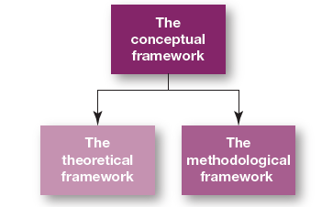
Three frameworks of the four frameworks approach to research

Slide 4
Questionnaires and Scales
When engaging a large population in a research project, it is not possible to engage every member of the population in in-depth research.
So rather than exploring the phenomenon under investigation in great depth, the researcher designs a research instrument which facilitates a broad approach to researching the phenomenon, using a large number of respondents.
A survey research methodology is an appropriate research methodology in such research.
Survey research is situated within a framework of positivism, it is deductive and it is used primarily to generate quantitative data. Questionnaires and/or scales are appropriate data gathering instruments in such research.
Questionnaires are structured data gathering methods. They are structured to ensure that each respondent is asked the same simple, clear, concise and precise questions, and structured to ensure that the responses made to those questions/issues are also simple, clear, concise and precise.
The data gathered by researchers engaged in very large studies
tends to be mostly or entirely quantitative data; that is, data in
numeric form or data that can easily be converted into numeric
form.

Slide 5
Errors in Survey Research
There are two major sources: random sampling error and systematic error.
Figure 15.2 in the textbook outlines the various forms of survey error.

Slide 6
Types of Error
Random Sampling Error
Sample Bias
Systematic Error
Respondent Error
Non-response Error
Response Bias

Slide 7
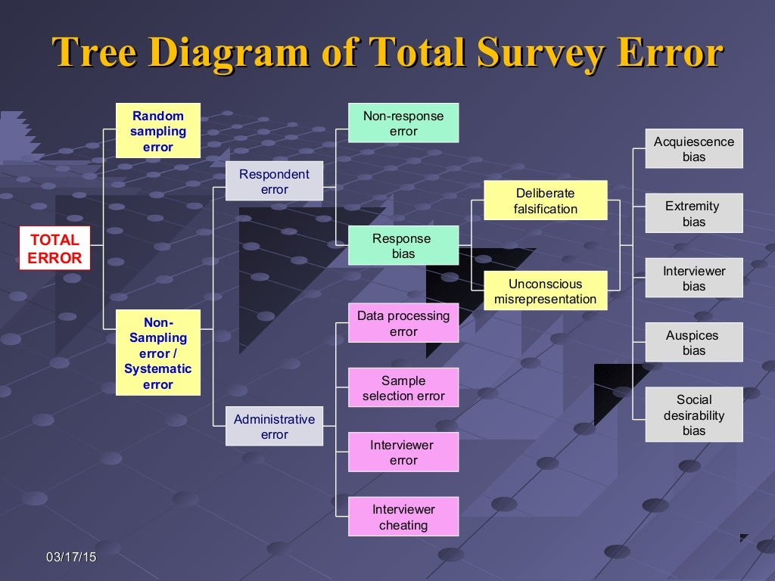

Slide 8
Questionnaires
Questionnaires tend to be very precisely structured data gathering instruments.
They are widely used in survey research.
Questionnaires are used primarily in quantitative research to generate quantitative data, although qualitative data can be generated by questionnaires, through the use of open questions.
Quantitative data is factual data.
The gathering of quantitative data in a research project
indicates a positivistic perspective in the research, and
a positivistic philosophical framework for the research.

Slide 9
Sample Questionnaire
There are three questions in the sample questionnaire (detailed on following slide).
The questions asked are simple, clear, concise and precise, and so too are the responses to those questions.
Note that the questionnaire has been designed to allow for the coding of responses to the questionnaire.
The coded responses are detailed on the
right-hand side of the questionnaire; (we
explore the coding of data and the analysis
of data, both quantitative and qualitative
data, in later chapters).

Slide 10
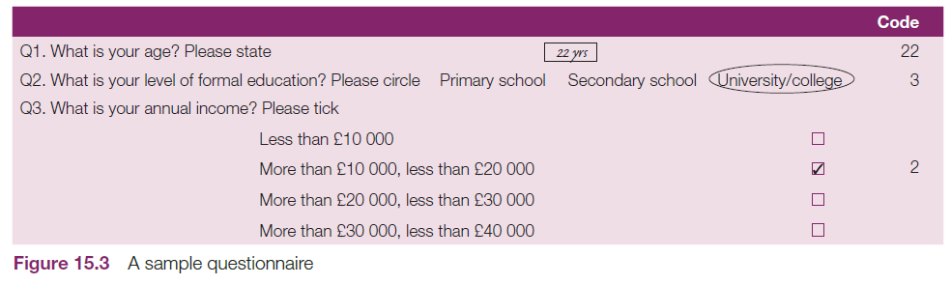
Sample Questionnaire

Slide 11
Designing a Questionnaire
The key issues when designing a questionnaire are:
  The content of the questions.
  The construction and presentation of each of the questions.
  The order of the questions.
  The length of the questionnaire.
The best guide to the design of an appropriate question, to begin with, is the conceptual framework of your research project.

Slide 12
Type & Form of questions
Open ended versus Close ended questions.
Positively and negatively worded questions.
Double barrelled questions.
Ambiguous questions.
Recall-dependent questions.
Leading questions.
Loaded questions.
Social Desirability

Slide 13
Examples
Many people are using dry cleaning less because of improved wash and wear clothes. How do you feel wash and wear clothes have affected your use of dry cleaning facilities in the past few months?
“Don’t you think that in these days of escalating costs of living, employees should be given good pay rises?”
“To what extent do you think management is likely to be vindictive if the union decides to go on strike?”
“Do you think there is a good market for the product and that it will sell well?”

Slide 14
Examples
How often you brush your teeth?
Some people have time to brush two to three times a day, how often do you brush your teeth in a day?
Please check which, if any, of the following sources of information about investments you regularly use?
“Do you think that older people should be laid off?”

Slide 15
Examples of Questionnaires
When you are designing a questionnaire for your research project, along with your study of survey research and questionnaires in this and other textbooks, you should examine examples of questionnaires used in other research projects.
You will find these detailed and explained in journal articles.
When you have collected a number of such questionnaires, examine them.

Slide 16
Examining questionnaires
Study the way in which they are presented in terms of both organization and the aesthetics.
Study the structure and the sequence of questions and items.
Take note of which questions are asked first, and which questions came later.
Study the words, concepts and language used.
Examine the manner in which questions are presented.
Take note of the manner in which the respondent was required to respond to the questions, ticking
boxes, inputting words and/or numbers, writing
phrases and/or sentences.

Slide 17
continued….
7. Note the structure and presentation of the closed questions, and the way in which the respondent is required to respond to them.
8. Note the structure and presentation of the open questions, and the way in which the respondent is required to respond to them.
9. Note all of the different question formats in the questionnaires.
10. Note skips and filters and the ways in which they are used.
Note the length of the questionnaires. Questionnaires are designed to be concise and precise data gathering methods, they should be as long
as is necessary, and as short as is possible.

Slide 18
Presentation of the Questionnaire
The presentation of the questionnaire should be simple, succinct, and professional.
The spacing of the questions should be logical and aesthetically pleasing.
Questionnaires are often sent to respondents by post, or by internal mail/post or by email. When this happens, obviously the researcher is not at hand to encourage the respondent to respond to the questionnaire. So the questionnaire must appeal to the respondent, aesthetically as well as in terms of its content, and it must appeal in terms of the rationale for the questionnaire and the research.
Creating aesthetically pleasing questionnaires takes a considerable amount of time and skill, but it is important to invest the time in this creative endeavor.

Slide 19
THE ISSUES OF VALIDITY AND RELIABILITY
As explained in Chapter 14, the issues of validity and reliability are treated differently in quantitative research and qualitative research.
In quantitative research, the researcher is primarily concerned with measurement and with the precision of the data gathering instruments they use or develop for use in their research projects.
The issues of validity and reliability in
quantitative research are explored in Table 15.1.

Slide 20
The Politics and Practicalities of Asking a Question
As explained, in quantitative research the researcher decides what needs to be known, and designs a very precise data gathering instrument to gather data in order to create knowledge.
In such a data gathering exercise, the researcher is the ‘expert’ and it is the researcher’s understanding of and/or perspective on the phenomenon that is explored or examined in such research.
In designing such a precise instrument, the researcher controls and even shapes the information that is gathered, and consequently the knowledge generated by the research project.
Critiques of such approaches to research stem from what are perceived as power issues.
The researcher has all the power in designing the research
project, and the researched are powerless.

Slide 21
Pilot Study
A pilot study is a test of the design of the research project, or a test of the data gathering instrument(s) designed for the research.
In general, all data gathering methods should be tested, and in your reading for the literature review and for the research methods element of your research, you will notice that almost every data collection method you come across will be subjected to a pilot study.
This is because the assumptions researchers make about how research subjects will respond to the questions and items presented to them in the data gathering methods designed for the research project are not always correct.
So, researchers test the data collection methods they
design. They test them to find out how, in reality,
participants will respond to their questions.

Slide 22
continued….
A pilot study, as explained, is carried out using a small number of respondents.
These respondents should be similar to the actual respondents in the study, but they should not be respondents in the study.
Usually pilot studies are carried out with five to fifteen respondents, depending on the size of the study.
In piloting a questionnaire and/or scale, the researcher wants to establish how respondents will respond to the questionnaire or scale, if they clearly understand each item and question in the questionnaire or scale, and if the responses they give to each item and question will be the responses required.
Any issues that the pilot study throws up can be dealt
with before the real study takes place.

Slide 23
Response Rates
Researchers are very fundamentally concerned with response rates.
A response rate in a research project is a count of the number of valid responses received to a data gathering exercise, for example the number of properly completed and returned questionnaires and/or scales.
The higher the response rate the better.
If every member of the study population or sample responds then the study will have a very complete data set.
In face-to-face data gathering exercises, it is not unusual to achieve 100% response rates, in telephone interviews it is not unusual to achieve 80% response rates.
In postal surveys and in online surveys, response rates are
often considerably lower than this. If the response rate is,
for example, 75%, then there is no data on the attitudes or
experiences of 25% of the study population or sample.

Slide 24
Generalisability
One claim that researchers sometimes make about their research is that it is generalisable.
Generalisability in research is the application of the findings of a research project beyond the specific context of the study.
In claiming that the findings of their research are generalisable, what the researcher means is that the findings and conclusions s/he has drawn from his study can be applied more generally.
The rule is, the bigger the sample population of the study, the more you can generalise.
This is the reason why only quantitative research is said to be, if sound design and sampling procedures have been used, generalisable; qualitative research is said to be transferable rather than generalisable (see
Table 14.4, Chapter Fourteen).
Researchers are usually very focused on getting good
response rates in their research and very active in
encouraging as many responses as possible in order to be
able to claim that their research is generalisable.

Slide 25
Ways of improving response rates
Respondents can be contacted and encouraged to respond.
Incentives can be given in order to improve response rates; the value of the research, when clearly explained, is often incentive enough.
Clear and persuasive information sheets and informed consent forms (see Chapter Three) can improve response rates.
The presentation, format and layout of questionnaires and scales can influence response rates.
Clarity, simplicity and brevity in the design of the data gathering instrument will help improve response rates.
The use of a covering letter can improve response rates.
Sending stamped addressed envelopes with postal questionnaires will
improve response rates.
Addressing the envelopes containing postal questionnaires to a
specific person can help improve response rates.
Courtesy and respect will improve response rates.

Slide 26
Issues of Instrumentation in Cross cultural research
Back Translation- a way forward!!
Issues like idiomatic equivalence; conceptual equivalence; response equivalence; timing of the data collection and individual collecting the data..

Slide 27
Example why back translation is pivotal
Pepsi’s “Come alive with the Pepsi generation” when translated into Chinese means “Pepsi brings your ancestors from the grave.”
When American Airlines wanted to advertise its new leather first‐class seats to Mexico, its “Fly in Leather” campaign would have literally translated to “Fly Naked” in Spanish.

